Slide 1

DATA SCIENCE IST 687 Group Project
Avani Patel, Issak Hernandez,
Reid E. Yaworski, and Chensheng Ma

Slide 2
Project Agenda
Project background and overview
Descriptive Analytics
Understanding the problem
What happened?
Descriptive statistics
Data clean up
Diagnostic Analytics
Why did it happen?
What correlations with ADR can we find?
Predictive Analytics
What will happen next?
Supervised Machine Learning
Prescriptive Analytics
Actionable insight
What can be done?

Slide 3
Overview
01
02
03
PROBLEM
OUR PROCESS
TARGET
Finding the pattern
Defining the co-relations
Diving in further
Drawing the conclusions and testing the model
Suggestions for maximizing the Revenues
Factors that cause revenue (ADR) to go down

Slide 4
OUR PROCESS
Market Research
SVM Model
Defining the co-relations
Drawing the conclusions and testing the model
Finding the pattern
Diving in further
Linear Model / Associations
Model Prediction
Consumer demographics
Using statistics to find out the model accuracies
Use of association rules method to derive relations among the factors
Using a part of data separated to test the model we got

Slide 5


City Hotel: -5,41,545 Resort Hotel: -15,81,079
What is the Problem?
Annual Revenue Loss
Annual Revenue Gain
City Hotel: 12,09,264 Resort Hotel: 22,30,343

Slide 6

Descriptive Analytics
What data do we have ?
Who are our typical visitors?
Is there a pattern we see?

Slide 7
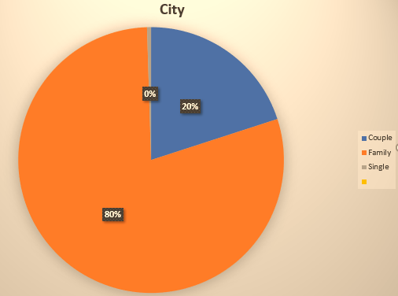
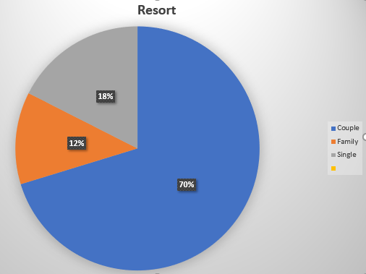
TYPICAL VISITOR
City
Resort
Visitor type: Family
Country: Portugal (PRT)
Season: Summer
Market Segment: Online TA
Customer Type: Transient
Visitor type: Couples
Country: Portugal (PRT)
Season: Summer
Market Segment: Online TA
Customer Type: Transient

Slide 8
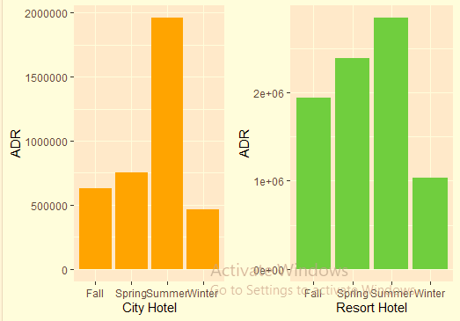
Seasonal Market
City vs Resort

Slide 9
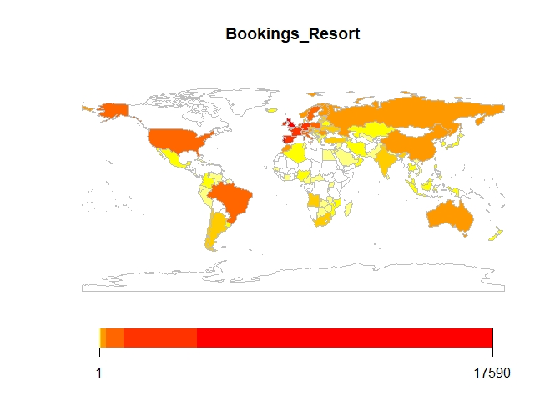
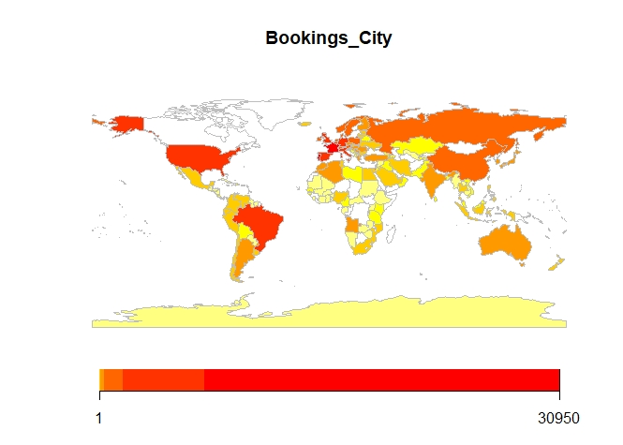
ANALYSIS
Popularity globally

Slide 10
Diagnostic Analytics
Which factors are affecting revenue the most?
Why do visitors cancel?
Why does ADR fluctuate?

Slide 11


Association Rules
Antecedent
Consequent
Customer Type
Cancellation
Market Segment
Cancellation
Season
Cancellation

Slide 12


Which factors are the most significant? (Linear Models)
Average Daily Revenue
Cancellations
City(54%) :
Season, Market Segment, AssignedRoomType, Meal, Agent, Length of Stay.
Resort(66%): AssignedRoomType, Season, MarketSegment, Meal
City(37%) :
LeadTime, Season, MarketSegment, Country, CustomerType, Agent
Resort(29%):
LeadTime, Season, MarketSegment, Country, CustomerType, Agent

Slide 13

Predictive Analytics
01
What happens next?
Machine Learning Models
SVM

Slide 14




SVM model
Numeric Variables
Strategize based on prediction of cancellation
Target groups
Development
ADR, Lead Time, Booking Changes, and times of special request.
Base on the result of SVM model to predict customer's cancellation status
Single visitor, Couples, and Family groups
Base on 78% accuracy of model to develop service quality for different visitor types

Slide 15
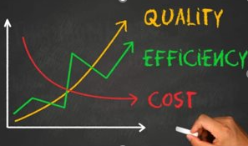
Prescriptive Analytics
01
How to solve it?
Maximizing the Revenue
Minimizing the Cost
Minimizing the Losses

Slide 16

OUR SUGGESTIONS
Dynamic pricing based on seasons
Package discounts
Global marketing
Overbook
By creating dynamic pricing, we can account for cyclic changes in seasonality
Package discounts help us to advertise deals and incentivize returning customers
By overbooking, we can anticipate cancellations and prevent unnecessary loss in ADR
With global marketing we can speak to our international customers and increase visitor travel from new countries
Staff Training
Training staff is a strong way of assuring visitor satisfaction and decreasing cancellations

Slide 17
Thank you !

